Slide 1
Evaluation of serum PVT1 biomarkers for predicting prostate cancer in men of African ancestry using machine learning
Tinovimba Hove¹, Olorunseun O. Ogunwobi², Emmanuel Asante-Asamani¹
¹ Clarkson University, Potsdam, NY; ² Michigan State University, East Lansing, MI
Page 1

Slide 2
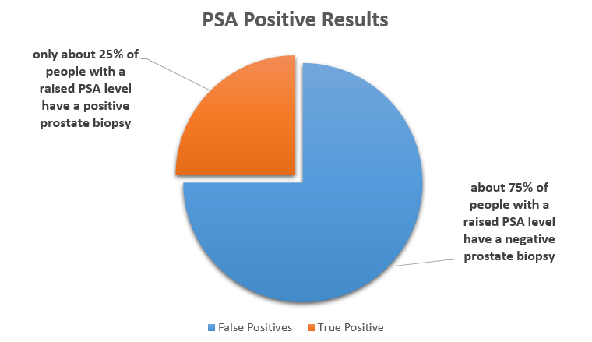
PCa is a leading cause of death by cancer in men
The Problem of PSA²
1 in 8 men will develop prostate cancer (PCa) in their lifetime. ¹
Current screening methods for PCa rely on prostate-specific antigen (PSA), a protein produced by the prostate gland that leaks into the bloodstream.
A PSA test measures the level of PSA in the blood. High PSA correlates with the presence of PCa (high sensitivity)
PSA leads to over-diagnosis and unnecessary biopsies (low specificity)
There is a critical need for new biomarkers that can improve the specificity of PSA
Page 2

Slide 3
Study Objective
Potential Solution
The Plasmacytoma variant translocation 1 (PVT1) is a long nonprotein coding gene associated with cancer progression.
PVT1 exons 4A, 4B, and 9 are over expressed in prostate tissues and human serum²
These specific exons could serve as valuable biomarkers for detecting prostate cancer.
Objective
This study evaluates the predictive power of PVT1 exons 4A, 4B, 9 in detecting PCa from human serum and improving the specificity of PSA
Page 3

Slide 4
Methods
Data Source
Copy numbers of PVT1 exons 4A, 4B,9, PSA from 144 multiracial men with elevated PSA.
Ogunwobi Lab at Michigan State University
Response & Explanatory Variables
Response Variable:
High-grade PCa risk – High grade (lethal) vs Not High Grade (non-lethal)
PCa risk – Healthy vs Cancer
Explanatory Variables: PSA, PVT1 Exon 4a, 4b, 9
Methods Overview
DATA LOADING & CLEANING
- Outlier Removal
- Normalization
DATA VISUALIZATION
- Boxplots
FEATURE SELECTION
- Z significance test
- Correlation Matrix
MODEL SELECTION
- Likelihood Ratio Test
- Multiple Logistic Regression
- ROC Curve, AUC
MODEL EVALUATION
- Multiple Logistic Regression
- Support Vector Machines
-Relevance Vector Machines
Page 4

Slide 5
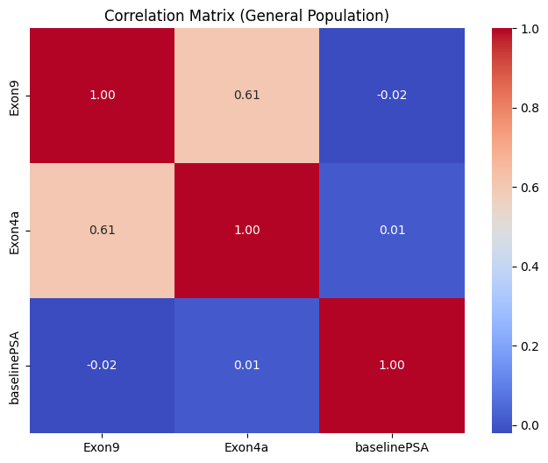
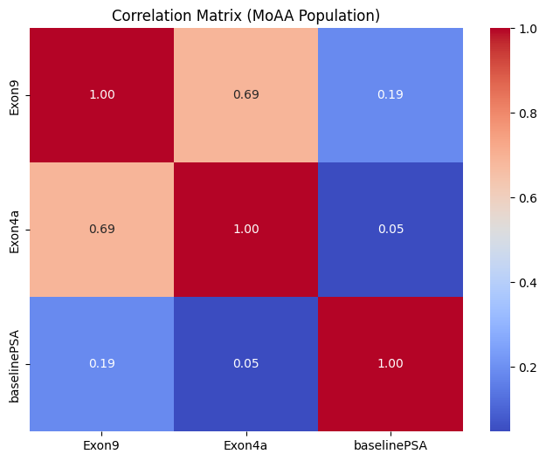
Correlation of Predictor Variables
Page 5

Slide 6
PCa Risk (Status) as a response factor in the General Population
Page 6

Slide 7
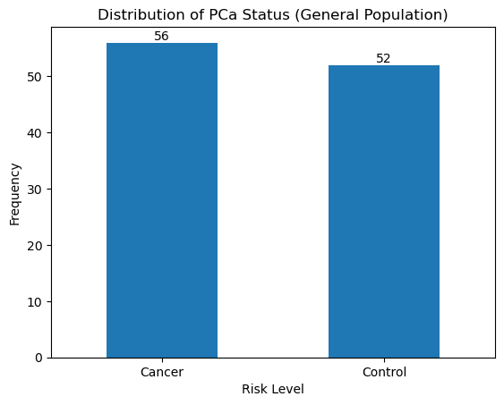
Data Distribution
Page 7

Slide 8
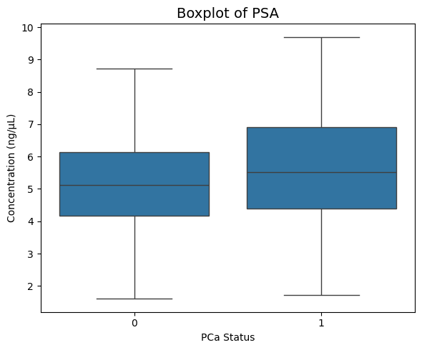
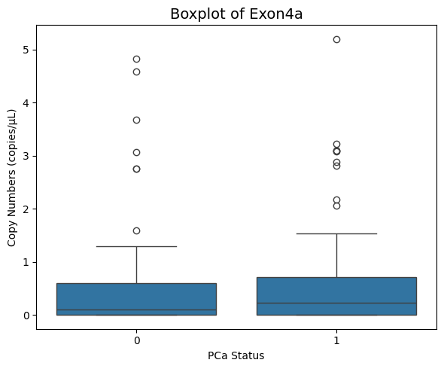
Data Visualization
Key
1 – Cancer
0 – No Cancer
P- value = 0.039 (@ 5% conf)
P- value = 0.651 (@ 5% conf)
Page 8

Slide 9
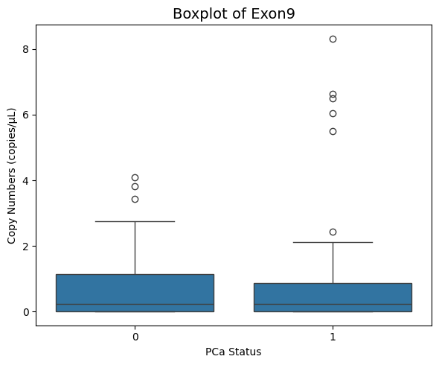
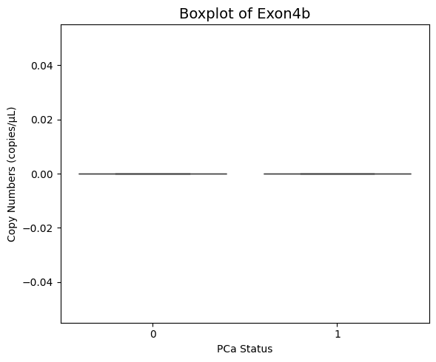
Data Visualization
Key
1 – Cancer
0 – No Cancer
P- value = 0.441 (@ 5% conf)
Page 9

Slide 10
Likelihood Ratio Test
Compare two nested models (one is a simpler version of the other)
Assess whether adding parameters significantly improves model fit
Comparison | P-value
PSA + Exon 9 vs. PSA Only | 0.4131
PSA + Exon 4a vs. PSA Only | 0.6622
PSA + Exon 9 + Exon 4a vs. PSA Only | 0.4110
PSA + Exon 9 + Exon 4a vs. PSA + Exon 9 | 0.9383
PSA + Exon 9 + Exon 4a vs. PSA + Exon 4a | 0.4862
Page 10

Slide 11
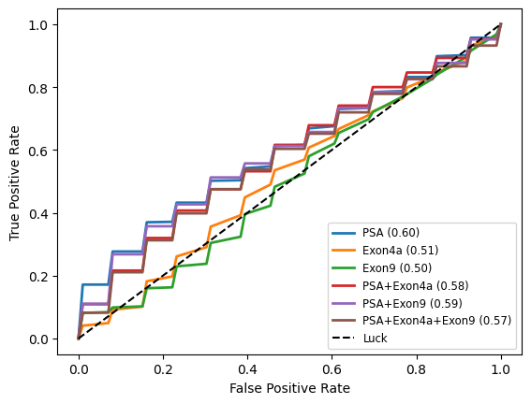
Multiple Logistic Regression Cross Validation and ROC
CV - technique used to assess the generalizability of a model by splitting the dataset into several parts or "folds.
K-fold cross validation
10- repetitions
ROC metric for evaluation across all possible threshold values for classification
Page 11

Slide 12
Multiple Logistic Regression Results
Model | Accuracy | Sensitivity | Specificity | PPV | NPV
PCa ~ β0+ β1PSA | 0.59 | 0.77 | 0.41 | 0.57 | 0.64
PCa ~ β0+ β1Exon4a | 0.5 | 1 | 0 | 0.5 | 0
PCa ~ β0+ β1Exon9 | 0.55 | 0.09 | 1 | 0 | 0.52
PCa ~ β0+ β1PSA+ β2Exon9 | 0.64 | 0.73 | 0.54 | 0.62 | 0.67
PCa ~ β0+ β1PSA+ β2Exon4a | 0.66 | 0.73 | 0.59 | 0.64 | 0.68
PCa ~ β0+ β1PSA+ β2Exon4a+ β3Exon9 | 0.64 | 0.68 | 0.59 | 0.62 | 0.65
Train-Test Split (60% - 40%), Youden's threshold
Page 12

Slide 13
Support Vector Machine Results
Model | Accuracy | Sensitivity | Specificity | PPV | NPV
PCa ~ β0+ β1PSA | 0.52 | 0.63 | 0.41 | 0.52 | 0.53
PCa ~ β0+ β1Exon4a | 0.50 | 1 | 0 | 0.50 | 0
PCa ~ β0+ β1Exon9 | 0.52 | 1 | 0.05 | 0.51 | 1
PCa ~ β0+ β1PSA+ β2Exon9 | 0.50 | 0.41 | 0.59 | 0.50 | 0.50
PCa ~ β0+ β1PSA+ β2Exon4a | 0.55 | 0.41 | 0.68 | 0.56 | 0.54
PCa ~ β0+ β1PSA+ β2Exon4a+ β3Exon9 | 0.59 | 0.46 | 0.73 | 0.63 | 0.57
Train-Test Split (60% - 40%)
Page 13
Notes:
Visualize the data

Slide 14
Relevance Vector Machine Results
Model | Accuracy | Sensitivity | Specificity | PPV | NPV
PCa ~ β0+ β1PSA | 0.33 | 0.67 | 0 | 0.40 | 0
PCa ~ β0+ β1Exon4a | 0.50 | 1 | 0 | 0.50 | 0
PCa ~ β0+ β1Exon9 | 0.33 | 0.33 | 0.33 | 0.33 | 0.33
PCa ~ β0+ β1PSA+ β2Exon9 | 0.33 | 0 | 0.67 | 0 | 0.40
PCa ~ β0+ β1PSA+ β2Exon4a | 0.50 | 1 | 0 | 0.50 | 0
PCa ~ β0+ β1PSA+ β2Exon4a+ β3Exon9 | 0.50 | 1 | 0 | 0.50 | 0
Train-Test Split (60% - 40%)
Page 14
Notes:
Visualize the data

Slide 15
MLR vs SVM vs RVM
Page 15
Notes:
Compare just the one model for the PSA +Pvt1 exon 9

Slide 16
PCa Risk (Status) as a response factor in men of African Ancestry
Page 16

Slide 17
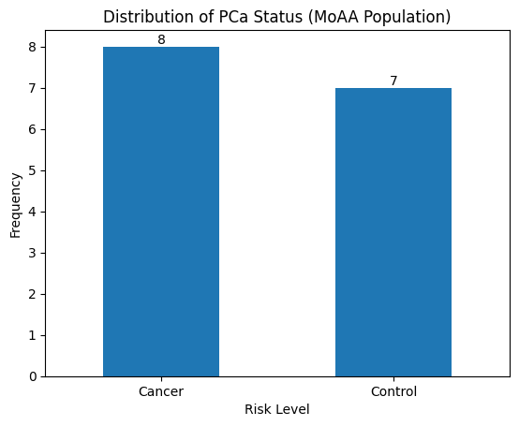
Data Distribution
Page 17

Slide 18
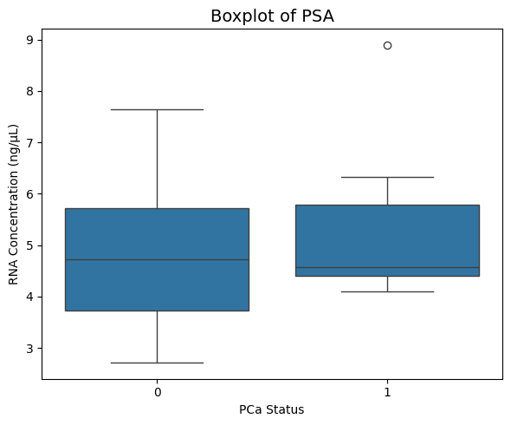
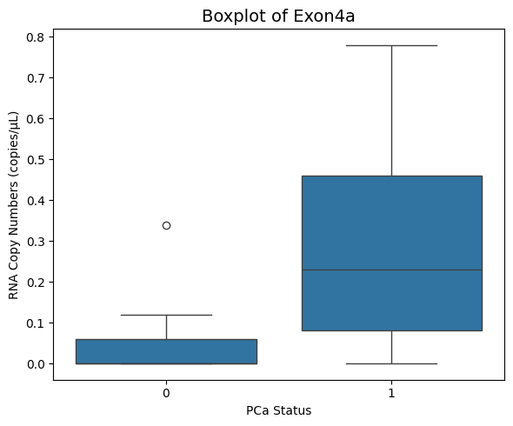
Data Visualization
Key
1 – Cancer
0 – No Cancer
P- value = 0.573 (@ 5% conf)
P- value = 0.072 (@ 5% conf)
Page 18

Slide 19
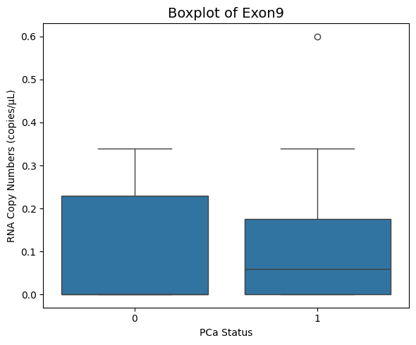
Data Visualization
Key
1 – Cancer
0 – No Cancer
P- value = 0.732 (@ 5% conf)
Page 19

Slide 20
Likelihood Ratio Test
Comparison | P-value
PSA + Exon 9 vs. PSA Only | 0.7548
PSA + Exon 4a vs. PSA Only | 0.0446
PSA + Exon 9 + Exon 4a vs. PSA Only | 0.0101
PSA + Exon 9 + Exon 4a vs. PSA + Exon 9 | 0.0107
PSA + Exon 9 + Exon 4a vs. PSA + Exon 4a | 0.1083
Page 20

Slide 21
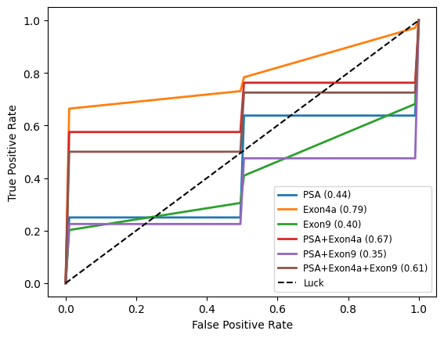
Multiple Logistic Regression Cross Validation and ROC
CV - technique used to assess the generalizability of a model by splitting the dataset into several parts or "folds.
K-fold cross validation
10- repetitions
ROC metric for evaluation across all possible threshold values for classification
Page 21

Slide 22
Multiple Logistic Regression Results
Model | Accuracy | Sensitivity | Specificity | PPV | NPV
PCa ~ β0+ β1PSA | 0.50 | 1 | 0 | 0.50 | 0
PCa ~ β0+ β1Exon4a | 0.83 | 1 | 0.67 | 0.75 | 1
PCa ~ β0+ β1Exon9 | 0.50 | 1 | 0 | 0.50 | 0
PCa ~ β0+ β1PSA+ β2Exon9 | 0.50 | 1 | 0 | 0.50 | 0
PCa ~ β0+ β1PSA+ β2Exon4a | 0.80 | 0.67 | 0.67 | 0.67 | 0.67
PCa ~ β0+ β1PSA+ β2Exon4a+ β3Exon9 | 0.50 | 1 | 0 | 0.50 | 0
Train-Test Split (60% - 40%), Youden's threshold
Page 22

Slide 23
Support Vector Machine Results
Model | Accuracy | Sensitivity | Specificity | PPV | NPV
PCa ~ β0+ β1PSA | 0.50 | 1 | 0 | 0.50 | 0
PCa ~ β0+ β1Exon4a | 0.50 | 1 | 0 | 0.50 | 0
PCa ~ β0+ β1Exon9 | 0.50 | 0.67 | 0.33 | 0.50 | 0.50
PCa ~ β0+ β1PSA+ β2Exon9 | 0.33 | 0.33 | 0.33 | 0.33 | 0.33
PCa ~ β0+ β1PSA+ β2Exon4a | 0.50 | 1 | 0 | 0.50 | 0
PCa ~ β0+ β1PSA+ β2Exon4a+ β3Exon9 | 0.33 | 0.33 | 0.33 | 0.33 | 0.33
Train-Test Split (60% - 40%)
Page 23

Slide 24
Relevance Vector Machine Results
Model | Accuracy | Sensitivity | Specificity | PPV | NPV
PCa ~ β0+ β1PSA | 0.50 | 1 | 0 | 0.50 | 0
PCa ~ β0+ β1Exon4a | 0.50 | 1 | 0 | 0.50 | 0
PCa ~ β0+ β1Exon9 | 0.50 | 0.67 | 0.33 | 0.50 | 0.50
PCa ~ β0+ β1PSA+ β2Exon9 | 0.33 | 0.33 | 0.33 | 0.33 | 0.33
PCa ~ β0+ β1PSA+ β2Exon4a | 0.50 | 1 | 0 | 0.50 | 0
PCa ~ β0+ β1PSA+ β2Exon4a+ β3Exon9 | 0.33 | 0.33 | 0.33 | 0.33 | 0.33
Train-Test Split (60% - 40%)
Page 24

Slide 25
MLR vs SVM vs RVM
Page 25

Slide 26
Risk of high-grade PCa as a response factor in the General Population
Page 26

Slide 27
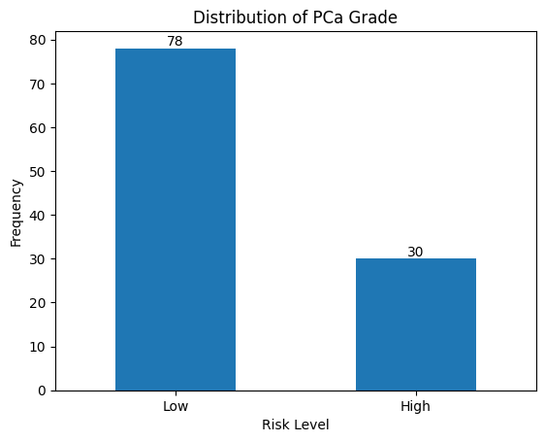
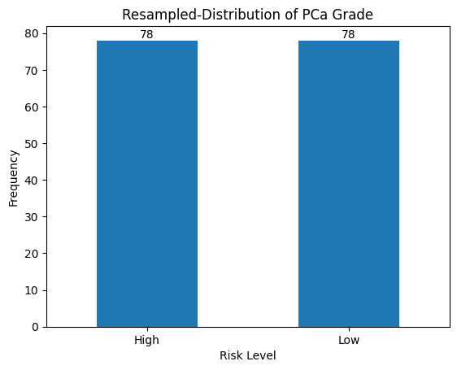
Data Distribution
Page 27

Slide 28
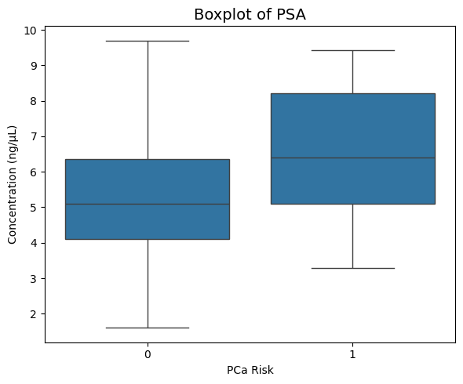
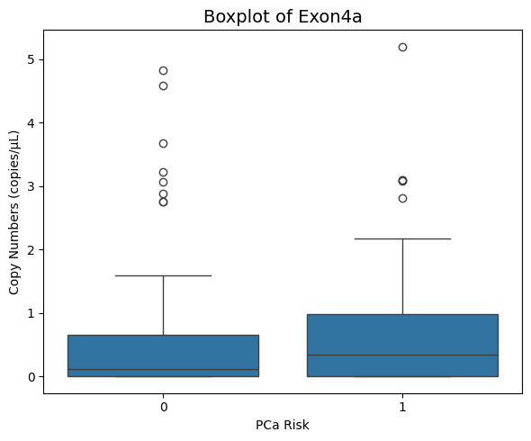
Data Visualization
Key
1 – High Grade
0 – Not High Grade
P- value = 0.000 (@ 5% conf)
P- value = 0.289 (@ 5% conf)
Page 28

Slide 29
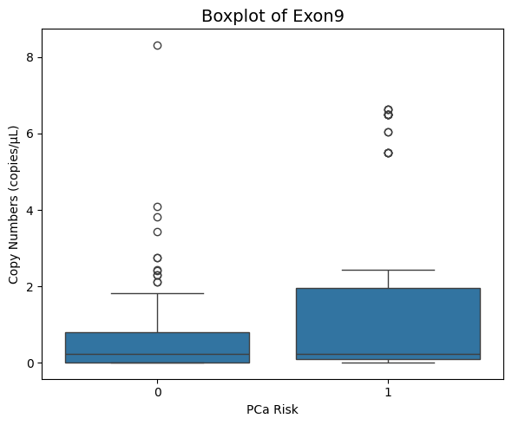
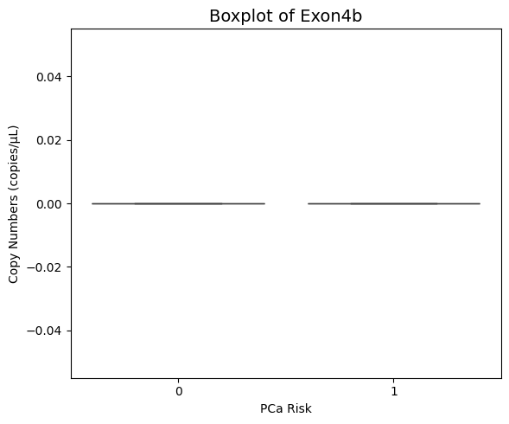
Data Visualization
Key
1 – High Grade
0 – Not High Grade
P- value = 0.011 (@ 5% conf)
Page 29

Slide 30
Likelihood Ratio Test
Comparison | P-value
PSA + Exon 9 vs. PSA Only | 0.0025
PSA + Exon 4a vs. PSA Only | 0.1182
PSA + Exon 9 + Exon 4a vs. PSA Only | 0.0024
PSA + Exon 9 + Exon 4a vs. PSA + Exon 9 | 0.8527
PSA + Exon 9 + Exon 4a vs. PSA + Exon 4a | 0.0093
Page 30

Slide 31
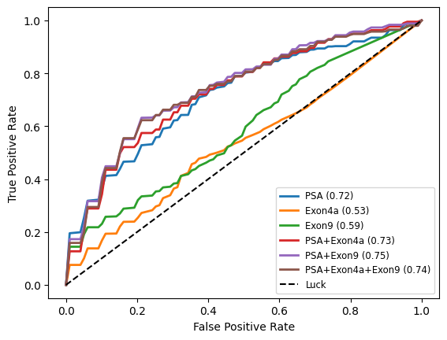
Multiple Logistic Regression Cross Validation and ROC
CV - technique used to assess the generalizability of a model by splitting the dataset into several parts or "folds.
K-fold cross validation
10- repetitions
ROC metric for evaluation across all possible threshold values for classification
Page 31

Slide 32
Multiple Logistic Regression Results
Model | Accuracy | Sensitivity | Specificity | PPV | NPV
PCa ~ β0+ β1PSA | 0.73 | 0.52 | 0.89 | 0.78 | 0.71
PCa ~ β0+ β1Exon4a | 0.57 | 0.04 | 0.97 | 0.50 | 0.57
PCa ~ β0+ β1Exon9 | 0.65 | 0.19 | 1 | 1 | 0.62
PCa ~ β0+ β1PSA+ β2Exon9 | 0.81 | 0.67 | 0.92 | 0.88 | 0.77
PCa ~ β0+ β1PSA+ β2Exon4a | 0.73 | 0.82 | 0.67 | 0.65 | 0.83
PCa ~ β0+ β1PSA+ β2Exon4a+ β3Exon9 | 0.81 | 0.67 | 0.92 | 0.86 | 0.79
Train-Test Split (60% - 40%), threshold Youden's index
Page 32
Notes:
Re-check this

Slide 33
Support Vector Machine Results
Model | Accuracy | Sensitivity | Specificity | PPV | NPV
PCa ~ β0+ β1PSA | 0.65 | 0.89 | 0.47 | 0.56 | 0.85
PCa ~ β0+ β1Exon4a | 0.43 | 1 | 0 | 0.43 | 0
PCa ~ β0+ β1Exon9 | 0.43 | 0.96 | 0.03 | 0.43 | 0.50
PCa ~ β0+ β1PSA+ β2Exon9 | 0.79 | 0.81 | 0.78 | 0.73 | 0.85
PCa ~ β0+ β1PSA+ β2Exon4a | 0.64 | 0.93 | 0.42 | 0.54 | 0.88
PCa ~ β0+ β1PSA+ β2Exon4a+ β3Exon9 | 0.71 | 0.70 | 0.72 | 0.66 | 0.77
Train-Test Split (60% - 40%)
Page 33

Slide 34
Relevance Vector Machine Results
Model | Accuracy | Sensitivity | Specificity | PPV | NPV
PCa ~ β0+ β1PSA | 0.71 | 0.64 | 0.77 | 0.70 | 0.72
PCa ~ β0+ β1Exon4a | 0.46 | 1 | 0 | 0.46 | 0
PCa ~ β0+ β1Exon9 | 0.56 | 0.76 | 0.40 | 0.51 | 0.67
PCa ~ β0+ β1PSA+ β2Exon9 | 0.71 | 0.76 | 0.67 | 0.66 | 0.77
PCa ~ β0+ β1PSA+ β2Exon4a | 0.75 | 0.76 | 0.73 | 0.70 | 0.79
PCa ~ β0+ β1PSA+ β2Exon4a+ β3Exon9 | 0.75 | 0.72 | 0.77 | 0.72 | 0.77
**Train-Test Split (65% - 35%)
Page 34

Slide 35
MLR vs SVM vs RVM
Page 35
Notes:
Compare just the one model for the PSA +Pvt1 exon 9

Slide 36
Risk of high-grade PCa as a response factor in men of African ancestry
Page 36

Slide 37
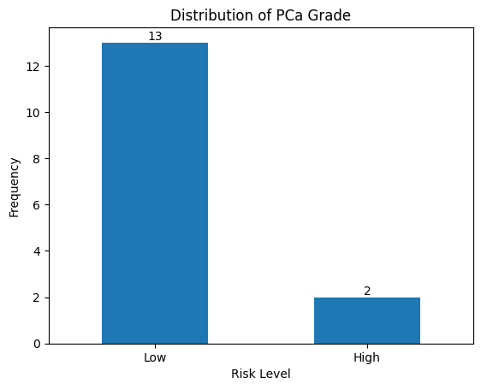
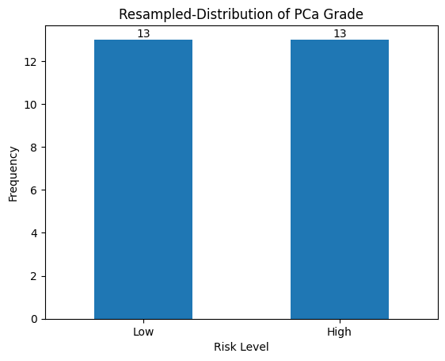
Data Distribution
Page 37

Slide 38
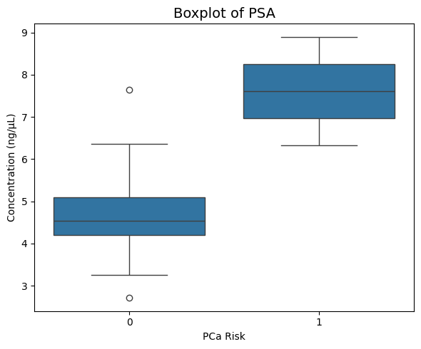
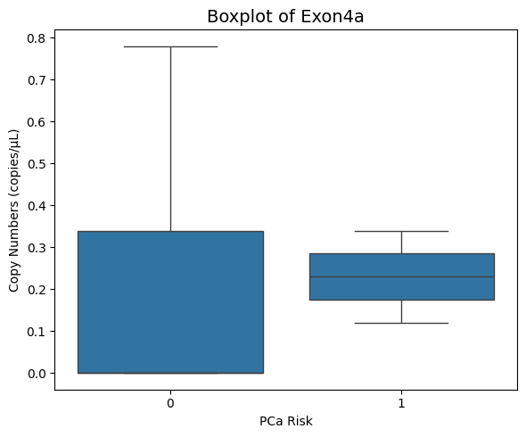
Data Visualization
Key
1 – High Grade
0 – Not High Grade
P- value = 0.000 (@ 5% conf)
P- value = 0.149 (@ 5% conf)
Page 38

Slide 39
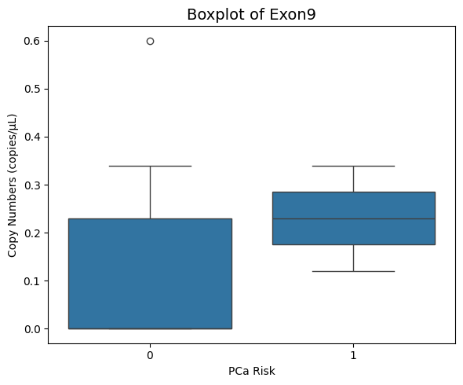
Data Visualization
Key
1 – High Grade
0 – Not High Grade
P- value = 0.008 (@ 5% conf)
Page 39

Slide 40
Likelihood Ratio Test
Comparison | P-value
PSA + Exon 9 vs. PSA Only | 0.5271
PSA + Exon 4a vs. PSA Only | 0.8118
PSA + Exon 9 + Exon 4a vs. PSA Only | 0.5107
PSA + Exon 9 + Exon 4a vs. PSA + Exon 9 | 0.8564
PSA + Exon 9 + Exon 4a vs. PSA + Exon 4a | 0.5397
Page 40

Slide 41
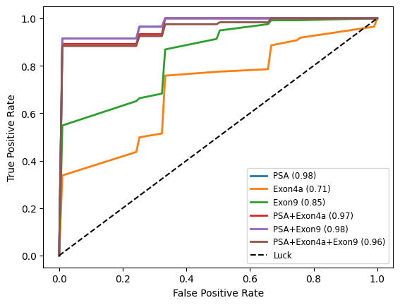
Multiple Logistic Regression Cross Validation and ROC
CV - technique used to assess the generalizability of a model by splitting the dataset into several parts or "folds.
K-fold cross validation
10- repetitions
ROC metric for evaluation across all possible threshold values for classification
Page 41

Slide 42
Multiple Logistic Regression Results
Model | Accuracy | Sensitivity | Specificity | PPV | NPV
PCa ~ β0+ β1PSA | 0.91 | 0.80 | 1 | 1 | 0.86
PCa ~ β0+ β1Exon4a | 0.73 | 0.80 | 0.67 | 0.67 | 0.80
PCa ~ β0+ β1Exon9 | 0.73 | 1 | 0.50 | 0.63 | 1
PCa ~ β0+ β1PSA+ β2Exon9 | 0.91 | 0.80 | 1 | 1 | 0.86
PCa ~ β0+ β1PSA+ β2Exon4a | 0.91 | 0.80 | 1 | 1 | 0.86
PCa ~ β0+ β1PSA+ β2Exon4a+ β3Exon9 | 0.91 | 0.80 | 1 | 1 | 0.86
Train-Test Split (60% - 40%), Youden's threshold
Page 42
Notes:
Why do a 50% 50% resampling

Slide 43
Support Vector Machine Results
Model | Accuracy | Sensitivity | Specificity | PPV | NPV
PCa ~ β0+ β1PSA | 0.82 | 1 | 0.67 | 0.71 | 1
PCa ~ β0+ β1Exon4a | 0.72 | 0.80 | 0.67 | 0.67 | 0.80
PCa ~ β0+ β1Exon9 | 0.64 | 0.80 | 0.50 | 0.57 | 0.75
PCa ~ β0+ β1PSA+ β2Exon9 | 0.82 | 1 | 0.67 | 0.71 | 1
PCa ~ β0+ β1PSA+ β2Exon4a | 0.91 | 1 | 0.83 | 0.83 | 1
PCa ~ β0+ β1PSA+ β2Exon4a+ β3Exon9 | 0.82 | 1 | 0.67 | 0.71 | 1
Train-Test Split (60% - 40%)
Page 43
Notes:
Color the main point, Why do a 50% 50% resampling

Slide 44
Relevance Vector Machine Results
Model | Accuracy | Sensitivity | Specificity | PPV | NPV
PCa ~ β0+ β1PSA | 0.82 | 1 | 0.67 | 0.71 | 1
PCa ~ β0+ β1Exon4a | 0.72 | 0.80 | 0.67 | 0.67 | 0.80
PCa ~ β0+ β1Exon9 | 0.64 | 0.80 | 0.50 | 0.57 | 0.75
PCa ~ β0+ β1PSA+ β2Exon9 | 0.73 | 0.80 | 0.67 | 0.67 | 0.80
PCa ~ β0+ β1PSA+ β2Exon4a | 0.91 | 1 | 0.83 | 0.83 | 1
PCa ~ β0+ β1PSA+ β2Exon4a+ β3Exon9 | 0.91 | 1 | 0.83 | 0.83 | 1
Train-Test Split (60% - 40%)
Page 44
Notes:
Color the main point, Why do a 50% 50% resampling

Slide 45
MLR vs SVM vs RVM
Page 45

Slide 46
Results Discussion & Future Work
Conclusion
PVT1 biomarkers can help reduce the existing disparity in PCa detection and management.
Addition of PVT1 Exon9 improves the predictive power of PSA in predicting the Risk of high-grade PCa in the general population
A model with PVT1 Exon4A gives the best predictive power of Risk of PCa in men of African ancestry
Future Scope
Future effort will be devoted to investigating the proposed models using a larger data set and other machine learning techniques
Page 46

Slide 47
Questions?
Thank you.
Page 47

